Slide 1
BLOWFISH
Blowfish is an algorithm of Bruce Schneier own design, intended for implementation on large microprocessors
The algorithm is unpatented, and the C code. Bruce Schneier designed Blowfish to meet the following design criteria.
1. Fast. Blowfish encrypts data on 32-bit microprocessors at a rate of 26 clock cycles per byte.
2. Compact. Blowfish can run in less than 5K of memory.
3. Simple. Blowfish uses only simple operations: addition, XORs, and table lookups on 32-bit operands. Its design is easy to analyze which makes it resistant to implementation errors.
4. Variably Secure. Blowfish’s key length is variable and can be as long as 448 bits.

Slide 2
Blowfish is optimized for applications where the key does not change often, like a communications
link or an automatic file encryptor. It is significantly faster than DES when implemented on 32-bit
microprocessors with large data caches, such as the Pentium and the PowerPC.
Blowfish is not suitable for applications, such as packet switching, with frequent key changes, or as a one-way hash function.
Its large memory requirement makes it infeasible for smart card applications.

Slide 3
Description of Blowfish
Blowfish is a 64-bit block cipher with a variable-length key.
The algorithm consists of two parts: key expansion and data encryption. Key expansion converts a key of up to 448 bits into several subkey arrays totaling 4168 bytes.
Data encryption consists of a simple function iterated 16 times. Each round consists of a keydependent permutation, and a key- and data-dependent substitution.
All operations are additions and XORs on 32-bit words.
The only additional operations are four indexed array data lookups per round.

Slide 4
Blowfish uses a large number of subkeys. These keys must be precomputed before any data
encryption or decryption.
The P-array consists of 18 32-bit subkeys:
P1, P2,..., P18
Four 32-bit S-boxes have 256 entries each:
S1,0, S1,1,..., S1,255
S2,0, S2,1,..., S2,255
S3,0, S3,1,..., S3,255
S4,0, S4,1,..., S4,255

Slide 5
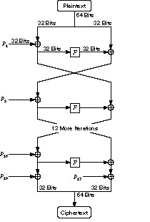
Blowfish.

Slide 6
Blowfish is a Feistel network consisting of 16 rounds. The input is a 64-bit data element, x. To encrypt:
Divide x into two 32-bit halves: xL, xR
For i = 1 to 16:
xL = xL Pi
xR = F(xL) xR
Swap xL and xR
Swap xL and xR (Undo the last swap.)
xR = xR P17
xL = xL P18
Recombine xL and xR

Slide 7
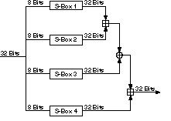
Function F.
Function F is as follows (see Figure):
Divide xL into four eight-bit quarters:
a, b, c, and d F(xL) = ((S1,a + S2,b mod 232) S3,c) + S4,d mod 232

Slide 8
Decryption is exactly the same as encryption, except that P1, P2,..., P18 are used in the reverse order.
Implementations of Blowfish that require the fastest speeds should unroll the loop and ensure that all subkeys are stored in cache.
The subkeys are calculated using the Blowfish algorithm. The exact method follows.
(1) Initialize first the P-array and then the four S-boxes, in order, with a fixed string. This
string consists of the hexadecimal digits of p.
(2) XOR P1 with the first 32 bits of the key, XOR P2 with the second 32-bits of the key, and so on for all bits of the key (up to P18). Repeatedly cycle through the key bits until the entire P-array has been XORed with key bits.

Slide 9
(3) Encrypt the all-zero string with the Blowfish algorithm, using the subkeys described in steps (1) and (2).
(4) Replace P1 and P2 with the output of step (3).
(5) Encrypt the output of step (3) using the Blowfish algorithm with the modified subkeys.
(6) Replace P3 and P4 with the output of step (5).
(7) Continue the process, replacing all elements of the P-array, and then all four S-boxes in order, with the output of the continuously changing Blowfish algorithm.
In total, 521 iterations are required to generate all required subkeys. Applications can store the subkeys—there’s no need to execute this derivation process multiple times.

Slide 10
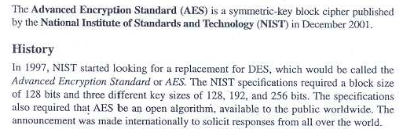
ADVANCED ENCRYPTION STANDARD (AES)

Slide 11
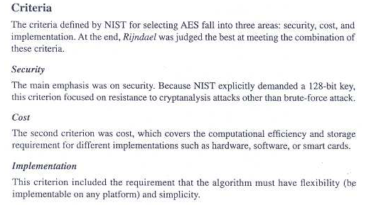

Slide 12
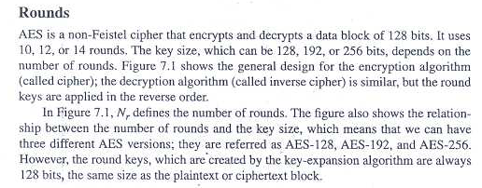

Slide 13

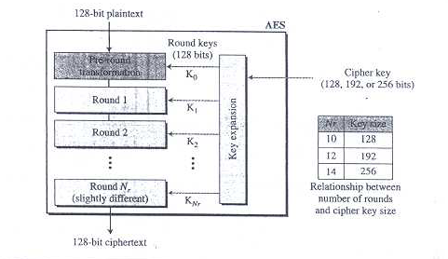

Slide 14


Slide 15
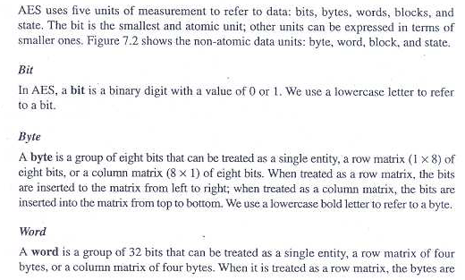
Data Units in AES

Slide 16
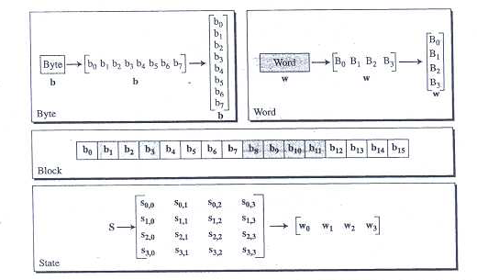


Slide 17
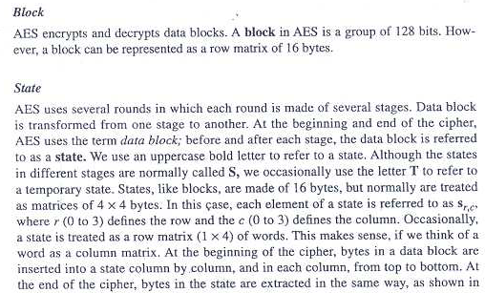

Slide 18
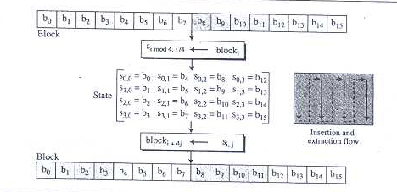
Block to State and State To Block Transformation

Slide 19
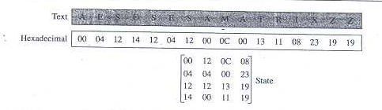
Changing Ciphertext To State

Slide 20
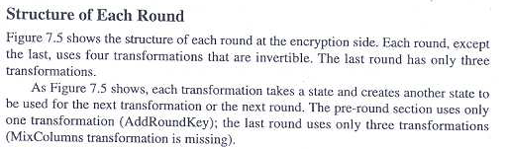

Slide 21
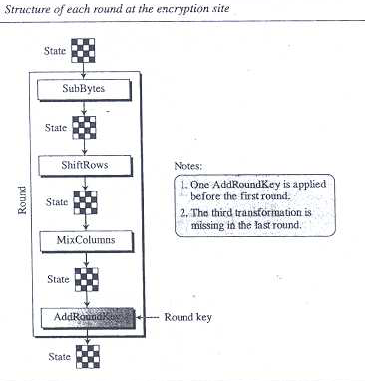

Slide 22
Overview of the Algorithm
AES uses a block length of 128 bits and a key length that can be 128, 192, or 256 bits.
In the description of this section, we assume a key length of 128 bits, which is likely to be the one most commonly implemented.
Figure shows the overall structure of AES.
The input to the encryption and decryption algorithms is a single 128-bit block. In FIPS PUB 197, this block is depicted as a square matrix of bytes.
This block is copied into the State array, which is modified at each stage of encryption or decryption. After the final stage, State is copied to an output matrix.
Similarly, the 128-bit key is depicted as a square matrix of bytes.
This key is then expanded into an array of key schedule words; each word is 4 bytes and the total key schedule is 44 words for the 128-bit key

Slide 23
. The ordering of bytes within a matrix is by column. So, for example, the first 4 bytes of a 128-bit plaintext input to the encryption cipher occupy the first column of the in matrix, the second 4 bytes occupy the second column, and so on.
Similarly, the first 4 bytes of the expanded key, which form a word, occupy the first column of the w matrix.

Slide 24
The following comments give some insight into AES:
1. One noteworthy feature of this structure is that it is not a Feistel structure.
Recall that in the classic Feistel structure, half of the data block is used to modify the other half of the data block, and then the halves are swapped.
AES does not use a Feistel structure but processes the entire data block in parallel during each round using substitutions and permutation.
2. The key that is provided as input is expanded into an array of forty-four 32-bit words, w [ i ].
Four distinct words (128 bits) serve as a round key for each round.

Slide 25
3. Four different stages are used, one of permutation and three of substitution:
• Substitute Bytes: Uses a table, referred to as an S-box, 3 to perform a byteby- byte substitution of the block
• Shift Rows: A simple permutation that is performed row by row
• Mix Columns: A substitution that alters each byte in a column as a function of all of the bytes in the column
• Add Round key: A simple bitwise XOR of the current block with a portion of the expanded key

Slide 26
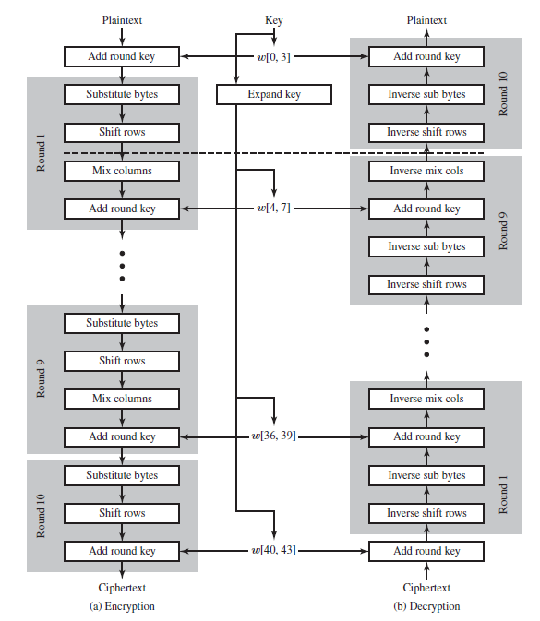

Slide 27
4. The structure is quite simple.
For both encryption and decryption, the cipher
begins with an Add Round Key stage, followed by nine rounds that eachincludes all four stages, followed by a tenth round of three stages. Figure depicts the structure of a full encryption round.

Slide 28
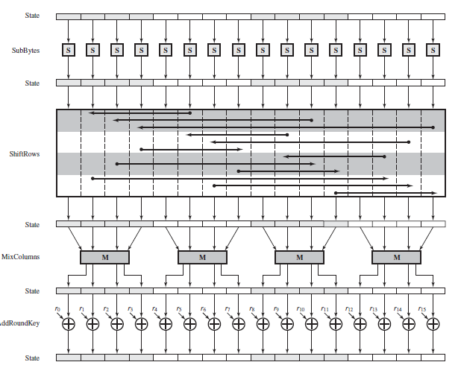

Slide 29
5. Only the Add Round Key stage makes use of the key. For this reason, the cipher begins and ends with an Add Round Key stage.
Any other stage, applied at the beginning or end, is reversible without knowledge of the key and so would add no security.
6. The Add Round Key stage by itself would not be formidable. The other three stages together scramble the bits, but by themselves would provide no security
because they do not use the key.
We can view the cipher as alternating operations
of XOR encryption (Add Round Key) of a block, followed by scrambling of the block (the other three stages), followed by XOR encryption, and so on. This scheme is both efficient and highly secure.

Slide 30
7. Each stage is easily reversible. For the Substitute Byte, Shift Row, and Mix Columns stages, an inverse function is used in the decryption algorithm.
For the Add Round Key stage, the inverse is achieved by XORing the same round key to the block, using the result that A ⊕ A ⊕ B B.
8. As with most block ciphers, the decryption algorithm makes use of the expanded key in reverse order. However, the decryption algorithm is not identical to the encryption algorithm. This is a consequence of the particular structure of AES.

Slide 31
9. Once it is established that all four stages are reversible, it is easy to verify that decryption does recover the plaintext. Figure 20.3 lays out encryption and decryption going in opposite vertical directions. At each horizontal point
(e.g., the dashed line in the figure), State is the same for both encryption and decryption.
10. The final round of both encryption and decryption consists of only three stages. Again, this is a consequence of the particular structure of AES and is required to make the cipher reversible.

Slide 32
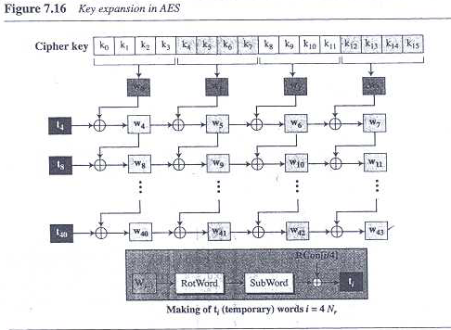

Slide 33
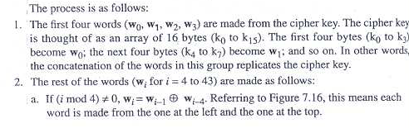

Slide 34
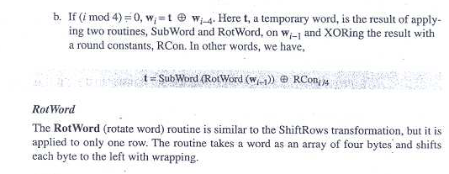

Slide 35
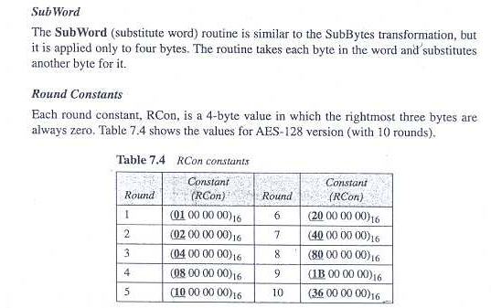

Slide 36
